Slide 1

Richard’s 8 secrets of success
Notes:
The picture on the slide is from the video at this website: http://www.ted.com/talks/richard_st_john_s_8_secrets_of_success.html
Note: There are two swear words in the video and slide 17, but they are used in a funny way that is not insulting or hurtful to anyone.
‘8 Secrets of Success’ Lesson Plan
- Start with a brainstorm of ‘success’ so the teacher can see SS vocab on the topic and introduce the topic. Or, ask the students “what do you think is important for success?” or “what leads to success?” or “what do you think are the 8 secrets of success?”
- Vocab activity using the main vocab in the video: passion, focus, serve, push yourself, persist, shy, shyness, doubt, etc. (For example: a mingle activity with a word and a meaning on paper slips and each student has a word or meaning and students mingle and match the words and meanings; “guess the meaning” game with points for each guess and double points for the right meaning; students or groups have dictionary race where they race to find the word in the dictionary)
- Optional: introduce TED and ‘Tedsters’.
- Slide 1 - Tell SS you will play a video. Tell SS the video is called “8 steps to success”. Explain that after the video the class will discuss the 8 steps to success.
- Slide 2 – the video - Ask SS to watch and listen for the main ideas and not to worry about unknown vocabulary.
- Play the short video clip.
- Slide 3 - After the short video clip, ask students to remember: What were the 8 steps to success? Or “What were the main ideas in the video?” Let the students discuss and remember in pairs, small groups, or mingle.
- Slide 4 to Slide 17 - Continue the PPT presentation from slide 3 on the first step to success (passion). The presentation goes through each step to success and there is a question (or two) for each step. This can be done in small discussion groups or while mingling and walking around, or a written survey of other students’ ideas and thoughts, or as a whole class. 1) Show the slide and question, 2) check comprehension, 3) give them 2-5 minutes to mingle/discuss/survey, 4) signal for students to stop, 5) optional whole-class discussion, 5) next slide and question, and repeat steps 2 to 5.
- Slide 18 – Ask the students: Can you remember the 8 secrets to success? See the notes on slide 18 for a possible vocabulary activity.
- Slide 19 - See if the students have questions (about the ideas in the video, vocab and/or success) before you continue to the discussion questions.
- Slide 20 to 23 – Some questions for discussion. Depending on the number of students and range of levels, discussion can be in pairs, in groups or as a whole-class. Alternatively, students can write a response to the questions anonymously and swap their responses and the class or groups decide who wrote the response.

Slide 2

What are you passionate about?
Notes:
What are you passionate about?
The picture on the slide is from the video at this website: http://www.ted.com/talks/richard_st_john_s_8_secrets_of_success.html

Slide 3
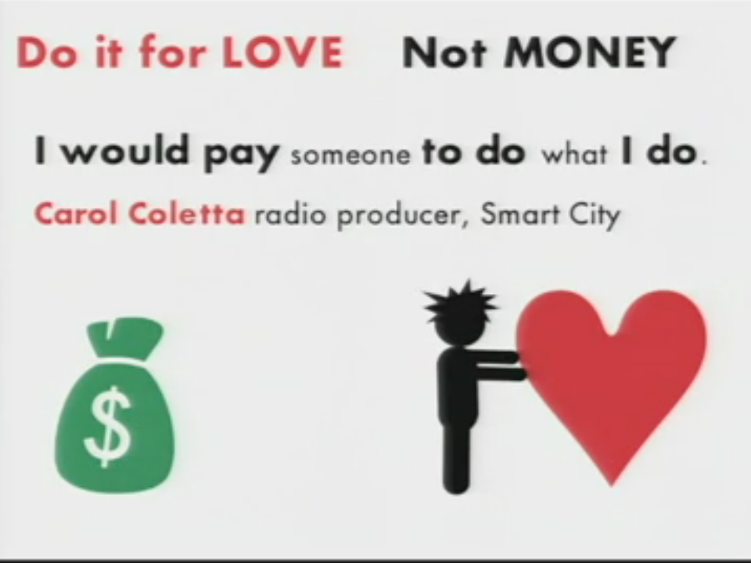
What would you do for love and not for money?
Notes:
What would you do for love and not money?
The picture on the slide is from the video at this website: http://www.ted.com/talks/richard_st_john_s_8_secrets_of_success.html

Slide 4

What do you
do that is hard work but is also
fun?
Notes:
What do you do that is hard work yet is also fun?
The picture on the slide is from the video at this website: http://www.ted.com/talks/richard_st_john_s_8_secrets_of_success.html

Slide 5
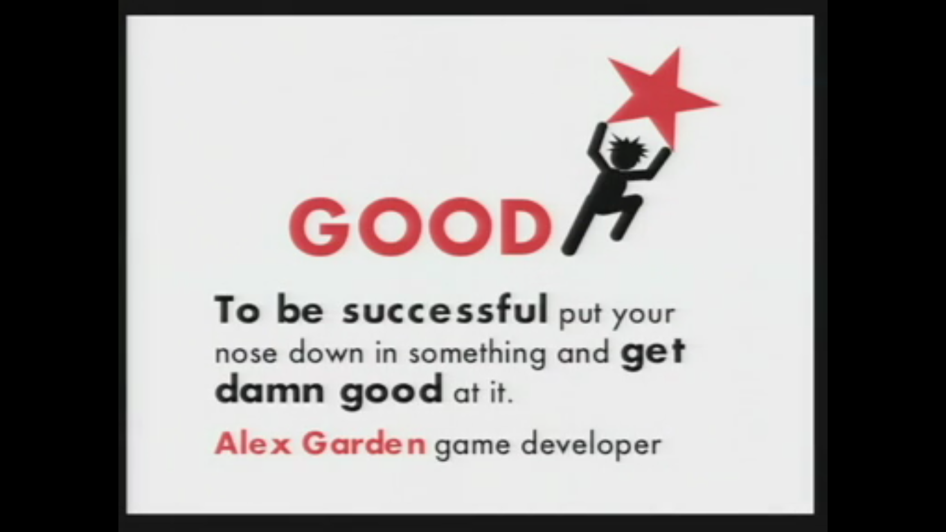
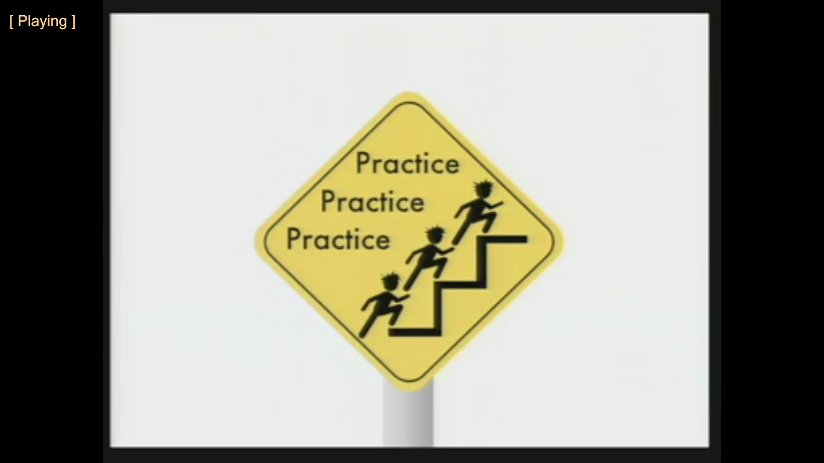
What are you good at?
What do you want to be good at?
Notes:
What are you good at? What do you want to be good at?
The picture on the slide is from the video at this website: http://www.ted.com/talks/richard_st_john_s_8_secrets_of_success.html

Slide 6
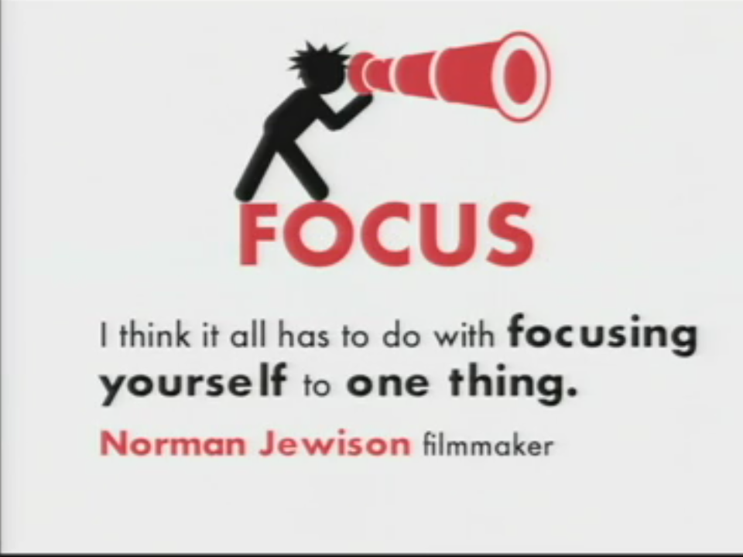
What do you focus on? (Now)
What would you like to focus on? (later in life)
Notes:
What do you focus on? (Now)
What would you like to focus on? (later in life)
The picture on the slide is from the video at this website: http://www.ted.com/talks/richard_st_john_s_8_secrets_of_success.html

Slide 7

How do you push yourself to succeed?
Notes:
How do you push yourself to succeed?
The picture on the slide is from the video at this website: http://www.ted.com/talks/richard_st_john_s_8_secrets_of_success.html

Slide 8
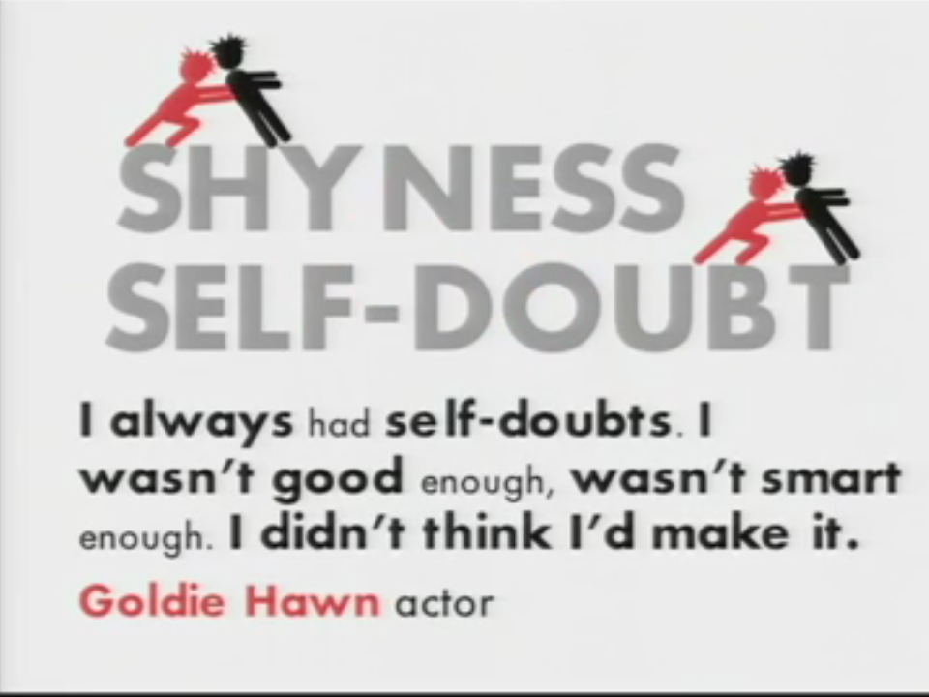
Can you push yourself through
doubt and shyness?
Who or what pushes you?
Notes:
Can you push yourself through doubt and shyness?
The picture on the slide is from the video at this website: http://www.ted.com/talks/richard_st_john_s_8_secrets_of_success.html

Slide 9

Who pushes you to succeed?
Notes:
Who pushes you to succeed?
The picture on the slide is from the video at this website: http://www.ted.com/talks/richard_st_john_s_8_secrets_of_success.html

Slide 10

What do you want to do for others?
Notes:
What do you want to do for others?
The picture on the slide is from the video at this website: http://www.ted.com/talks/richard_st_john_s_8_secrets_of_success.html

Slide 11
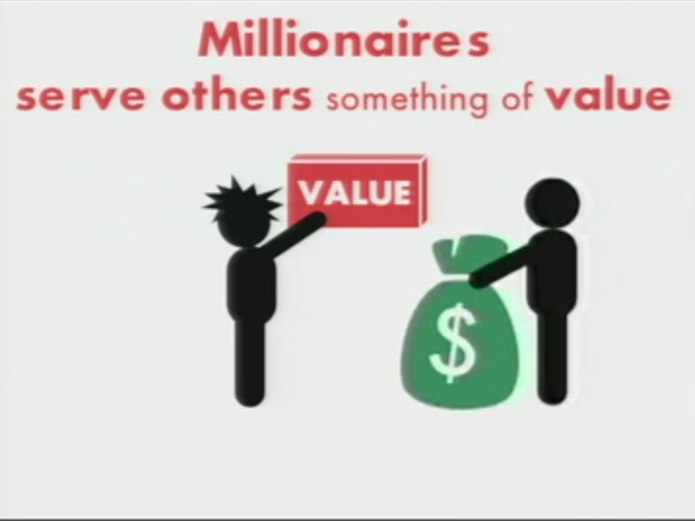
What can you do for or give to others that has value.
Notes:
What can you do for or give to others that has value.
The picture on the slide is from the video at this website: http://www.ted.com/talks/richard_st_john_s_8_secrets_of_success.html

Slide 12

Do you think something should
be different in
the world?
Can you make it
happen?
Do you have lots of ideas?
Notes:
Do you have lots of ideas?
Do you think something should be different in the world? Can you make it happen?
The picture on the slide is from the video at this website: http://www.ted.com/talks/richard_st_john_s_8_secrets_of_success.html

Slide 13
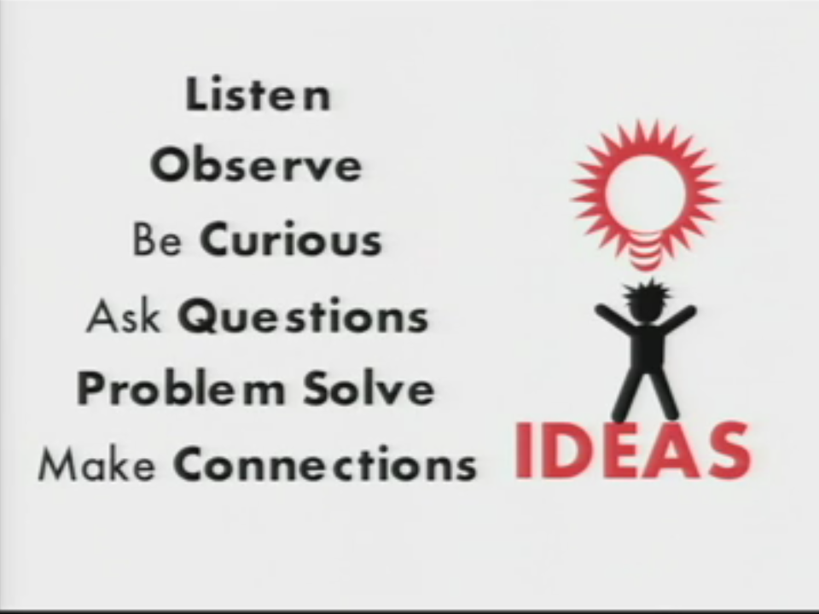
How many of these do you do often?
Notes:
How many of these do you do often?
The picture on the slide is from the video at this website: http://www.ted.com/talks/richard_st_john_s_8_secrets_of_success.html

Slide 14

When you try to do something, do you persist (do you keep trying again and again until you succeed)?
OR
When you try to do something, do you give up (stop trying after one try)?
Notes:
When you try to do something, do you persist (do you keep trying again and again until you succeed)? OR
When you try to do something, do you give up (stop trying after one try)?
The picture on the slide is from the video at this website: http://www.ted.com/talks/richard_st_john_s_8_secrets_of_success.html

Slide 15
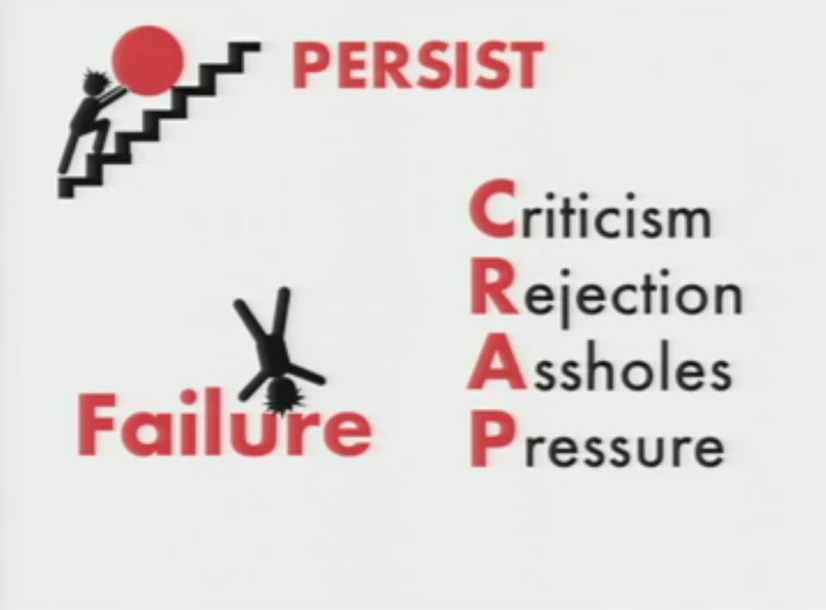
rrogance
Do you persist through failure and other challenges?
Notes:
Do you persist through failure and other challenges?
The picture on the slide is from the video at this website: http://www.ted.com/talks/richard_st_john_s_8_secrets_of_success.html

Slide 16
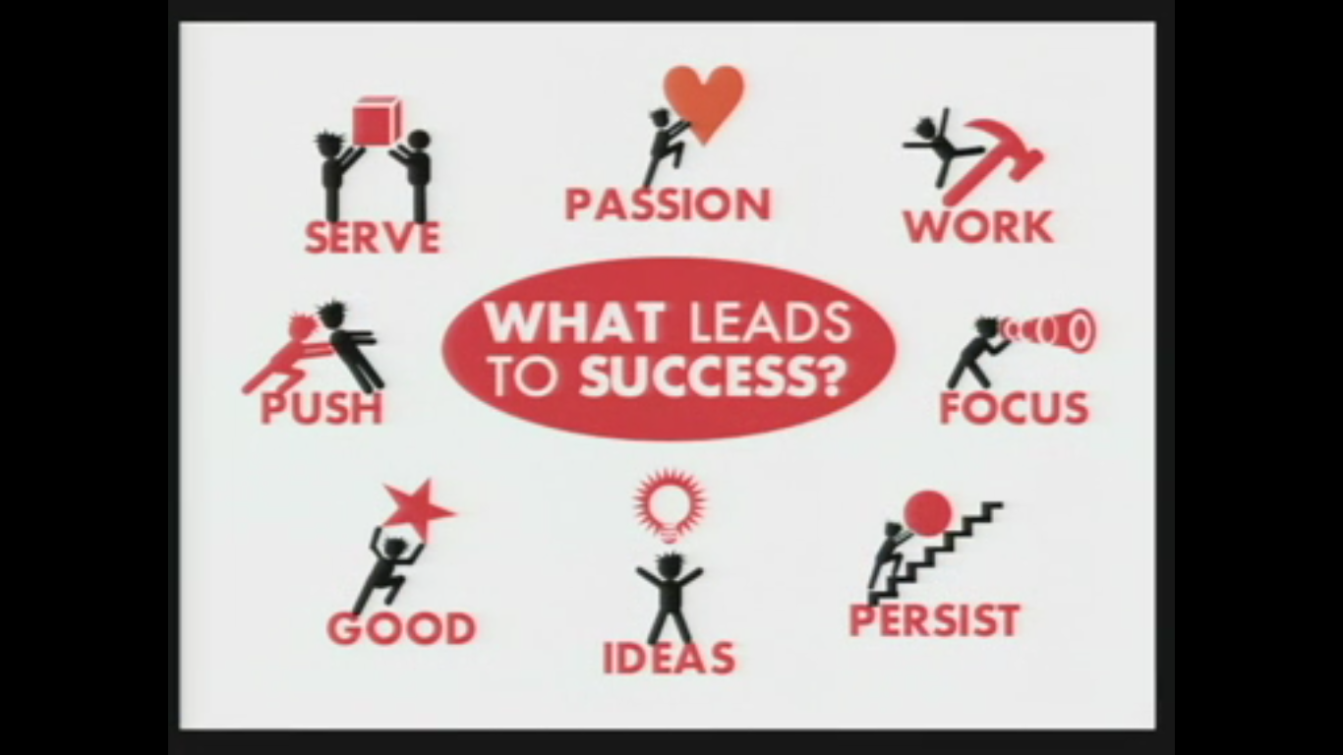
Can you remember….
Notes:
The picture on the slide is from the video at this website: http://www.ted.com/talks/richard_st_john_s_8_secrets_of_success.html
Optional activity: Students form groups and remember as many of the 8 steps as they can. It can be a team race activity: students can come to the board, the groups line up facing the board, and when the teacher says “GO!” the first person in each group writes one of the eight steps and then go to the end of their team’s line and the next person in line writes one of the eight steps and goes to the back of the line; this repeats until a team writes all 8 steps to success or time runs out.

Slide 17
Notes:
The picture on the slide is from the video at this website: http://www.ted.com/talks/richard_st_john_s_8_secrets_of_success.html
See if the students have questions before you continue to the discussion questions because I think discussion generated by students is better than teacher-generated discussion.
Depending on the number of students and levels, discussion can be in pairs, in groups or as a whole-class.

Slide 18


